Slide 1


No Place for Hate
First Colony Middle School
Bobcat Time: Monday
October is National Bullying Awareness Month

Slide 2

Anti-Defamation League
Who are we?
We are activists, educators and experts. We fight anti-Semitism and all forms of hate.
We help shape laws locally and nationally.
We work with students to respect inclusion and to challenge bias and bullying.

Slide 3

Ant-Defamation League
We train law enforcement officers about extremism, terrorism and hate crimes.
We never give up trying to build a better world inspired by our democratic sense of unity: There is no them – only us

Slide 4
Anti-Defamation League
Founded in 1913, the Anti-Defamation League (ADL) is our nation’s premier civil rights/human relations organization.
We mobilize people to engage in reasonable discourse as together we find solutions to serve our diverse society.
We speak up for those whose voices are not always heard.

Slide 5
ADL: Fighting Hate
Building a Better World Video
View the following video:
https://www.youtube.com/watch?v=UTSECAp202w&index=3&list=PLC9D00325BFBBD588

Slide 6

ADL’s No Place for Hate®
ADL’s No Place for Hate® initiative provides schools and communities with an organizing framework for combating bias, bullying and hatred, leading to long-term solutions for creating and maintaining a positive climate.

Slide 7
ADL’s No Place for Hate®
No Place for Hate schools receive their designation by:
Building inclusive and safe communities in which respect is the goal, and all students can thrive.
Empowering students, faculty, administration and family members to take a stand against hate and bullying by incorporating new and existing programs under one powerful message.
Engaging schools and communities in at least three anti-bias activities per year, which ADL helps to develop.
Sending a clear, unified message that all students have a place to belong.

Slide 8
ADL’s No Place for Hate®
FCMS earned this designation last year and will continue to do projects this year to become a No Place for Hate school.

Slide 9
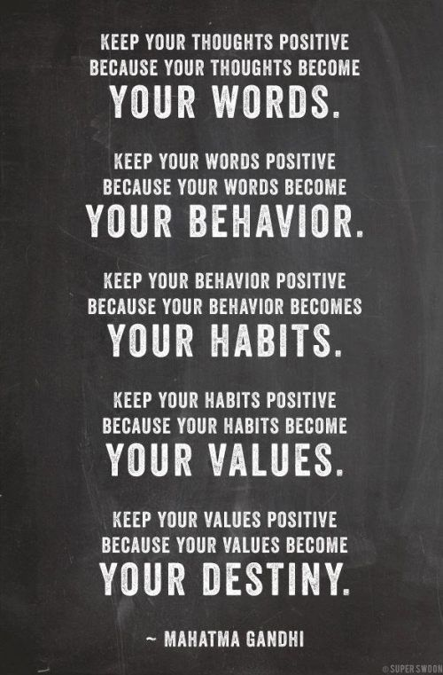
First Colony Middle School
Bobcat Time: Tuesday

Slide 10
No Place For Hate: Bullying Awareness
Bullying is a phrase we hear regularly and often: in the media, on TV shows and movies, in schools and in conversations among both adults and children.
Parents, students and schools are rightfully worried about bullying.
In the U.S., 22% of students age 12-18 report being bullied at school and 28% of young people will experience cyberbullying over the course of their lifetime.

Slide 11
Bullying Defined
Bullying:
The repeated action or threats of action directed toward a person by one or more people who have or are perceived to have more power or status than their target in order to cause fear, distress or harm. Bullying can be physical, verbal, psychological or any combination of these three.
When a person or a group behaves in ways—on purpose and over and over—that make someone feel hurt, afraid or embarrassed.

Slide 12
Bullying Defined
It is important to distinguish bullying from other unkind, mean and harmful behavior.
Calling someone a name or pushing someone once, being rude or having an argument with someone is not bullying.
These behaviors should be addressed, but may have different consequences and interventions, which is why the distinction is critical.

Slide 13
Bullying Defined
To be defined as bullying, all three components must be present:
  (1) repeated actions or threats,
  (2) a power imbalance and
  (3) intention to cause harm. If bullying is identified correctly, there are various ways to address it.

Slide 14
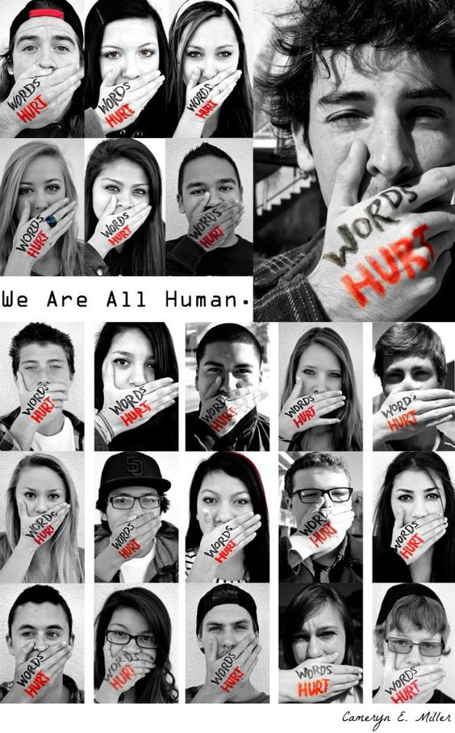
ADL’s No Place for Hate®
Let’s focus on the effect of the words we use and how they can hurt people.
View the following video: “The Power of Words”
https://www.youtube.com/watch?v=2OIfGoNfm4w

Slide 15
Discussion Questions
Do you know what bullying is? How is it different than mean behavior?
Have you ever experienced bullying? Can you tell me more about it?
What do students do when they see bullying take place in school?

Slide 16
That’s Not Funny
Bullying Awareness Activity
On a piece of paper about the size of a notecard write something mean that someone has said to you that you didn’t like. Or perhaps write something that you said about someone else. You do not have to put your name on it.
If possible, find a spot in the classroom where you can tape these on a wall, possibly by your teacher’s desk.
If not, just keep these…we will use them during Bobcat Time tomorrow.

Slide 17
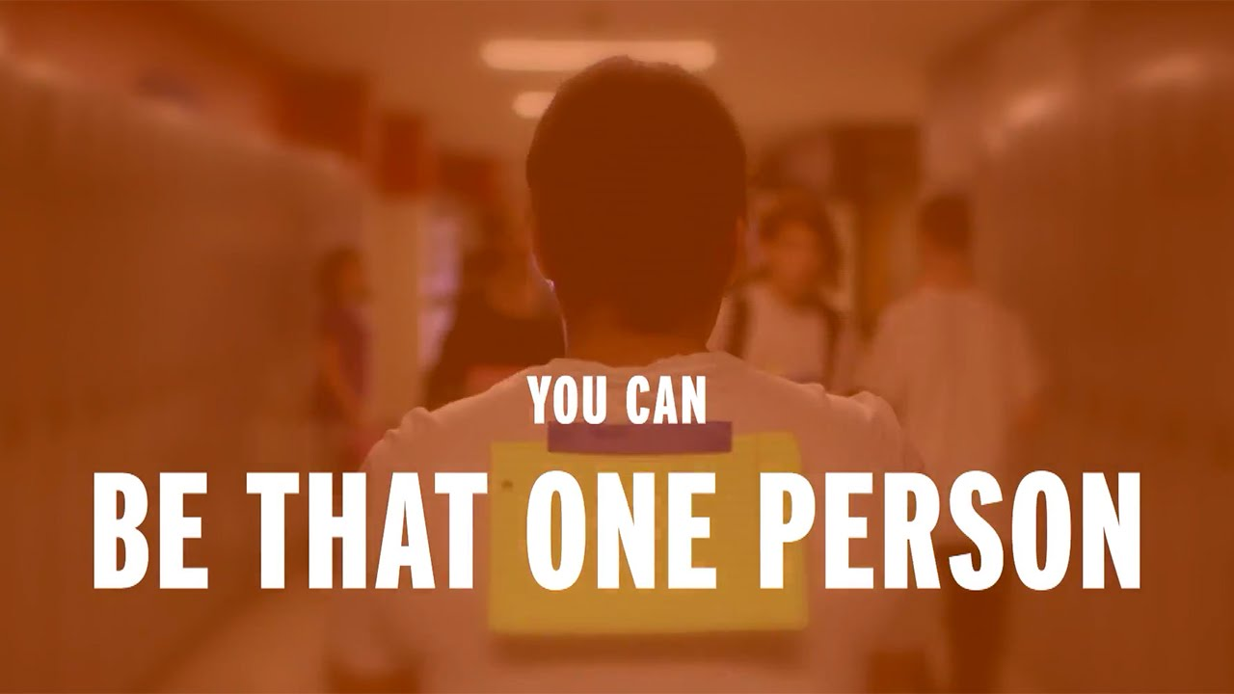
No Place for Hate
First Colony Middle School
Bobcat Time: Wednesday

Slide 18
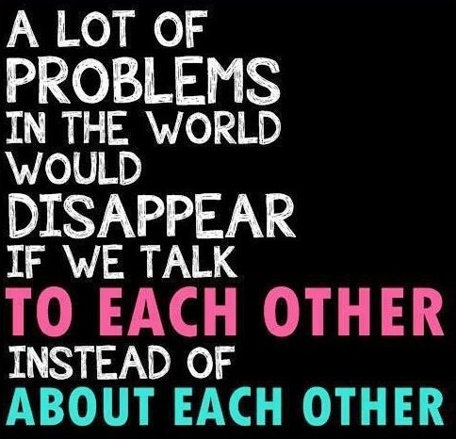
Be An Ally: Six Simple Ways
Here are some simple things you can do to be an ally to targets of name-calling and bullying.
Remember—always think about your safety first when deciding the best way to respond.

Slide 19
Be An Ally: Six Simple Ways
1. Support targets, whether you know them or not.
Show compassion and encouragement to those who are the targets of bullying behavior by asking if they’re okay, going with them to get help and letting them know you are there for them.

Slide 20
Be An Ally: Six Simple Ways
2. Don’t participate.
This is a really easy way to be an ally because it doesn’t require you to actually do anything, just to not do certain things—like laugh, stare or cheer for the bad behavior. You are sending a message that the behavior is not funny and you are not okay with treating people that way.

Slide 21
Be An Ally: Six Simple Ways
3. Tell aggressors to stop.
If it feels safe, stand tall and tell the person behaving badly to cut it out. You can just ask them to stop or say “hey, that’s not funny” on the spot or later during a private moment. Put an immediate stop to the bullying by: making a strong statement (“That’s not cool!”); challenging intentions (“It’s not a joke, it’s cruel.”); expressing how it feels (“That really hurts.”)

Slide 22
Be An Ally: Six Simple Ways
4. Inform a trusted adult.
Sometimes you may need extra help to stop the bullying. It’s important to tell an adult who you trust so that this person can be an ally to you as well as the target. Getting someone out of trouble is never “tattling” or “snitching.” So don’t think twice—reach out to a parent, teacher, guidance counselor, coach or someone else who will get involved.

Slide 23
Be An Ally: Six Simple Ways
5. Get to know people instead of judging them.
Appreciate people for who they are and don’t judge them based on their appearance. You may even find that they’re not so different from you after all.

Slide 24
Be An Ally: Six Simple Ways
6. Be an ally online.
Bullying happens online, too, and through the use of cell phones. Looking at mean Web pages and forwarding hurtful messages is just like laughing at someone or spreading rumors in person. So online and offline—do your part to be an ally to others.

Slide 25
That’s Not Funny
View the following video: Bullying is Not Funny
https://www.youtube.com/watch?v=4tKObeRwEOU

Slide 26
Discussion Questions
That’s Not Funny:
1. Take another piece of paper about the size of a notecard (same size as yesterday) and write something that you can say to someone who calls you names.
Ex. “That’s not funny. Stop-that’s not cool.”
2. Now tape this notecard OVER the comment that you wrote yesterday and COVER up the negativity.
Your wall should not have words of an ally-words to use to stand up for others. USE THESE WORDS!
3. Question to Dig Deeper: (if time)
How can we make our school safer and decrease or eliminate bullying?

Slide 27
Are You Ready to be an Ally?
If extra time… watch this “Choose Kindness” video
https://www.youtube.com/watch?v=B_wPO4yC0Yk
Resources:
adl.org

